Slide 1

Artificial Intelligence
Dr. Piyush Joshi

Slide 2
INFORMED (HEURISTIC) SEARCH STRATEGIES
It is designed to solve problems quickly.
NP to P

Slide 3
INFORMED (HEURISTIC) SEARCH STRATEGIES
Euclidean distance as a Heuristic
Good solution not optimal

Slide 4
INFORMED (HEURISTIC) SEARCH STRATEGIES
In this search, additional knowledge of the problem is imparted to the search algorithm.
Heuristics are shortcuts to solutions and heuristic algorithms are often used in AI to get a computer to find an approximate solution when an exact solution isn't possible or requires too much time or processing power.

Slide 5
INFORMED (HEURISTIC) SEARCH STRATEGIES
The general approach we consider is called best-first search.
We have estimated cost of the cheapest path from the state at node n to a goal state.
It always find a good solution but does not guarantee an optimal solution.

Slide 6
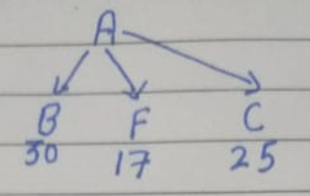
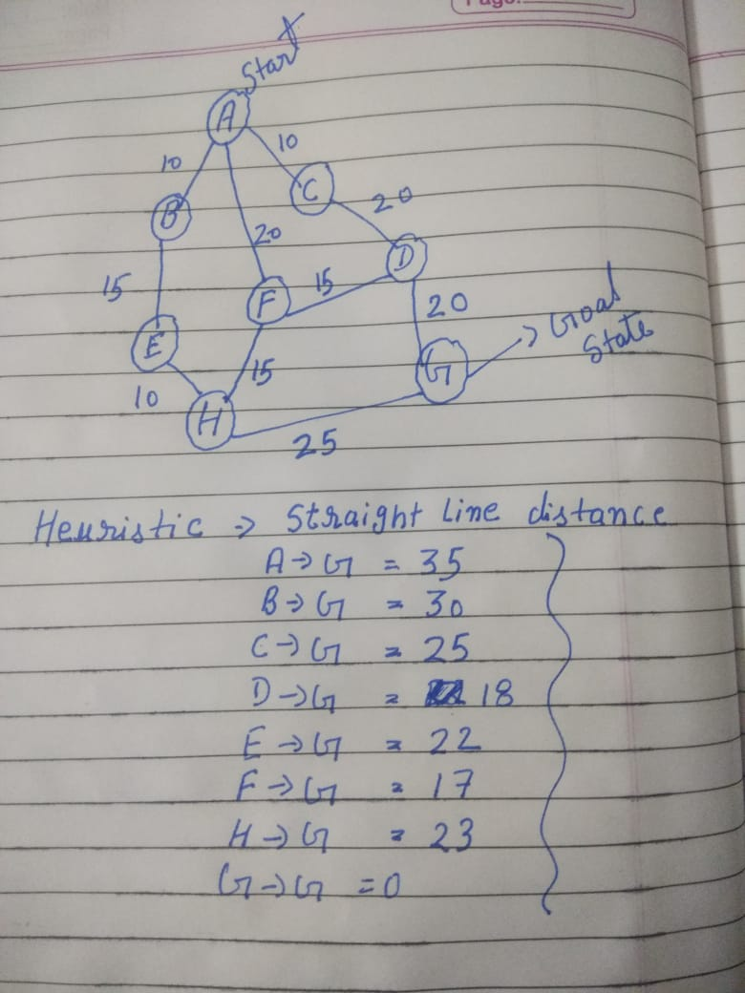
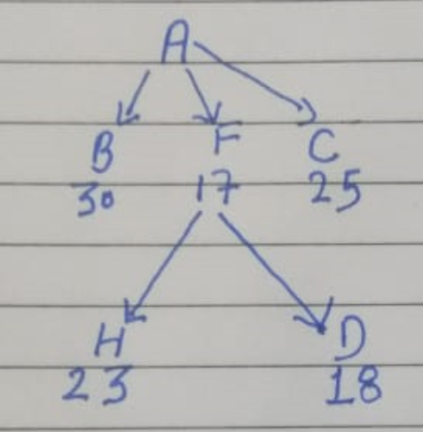
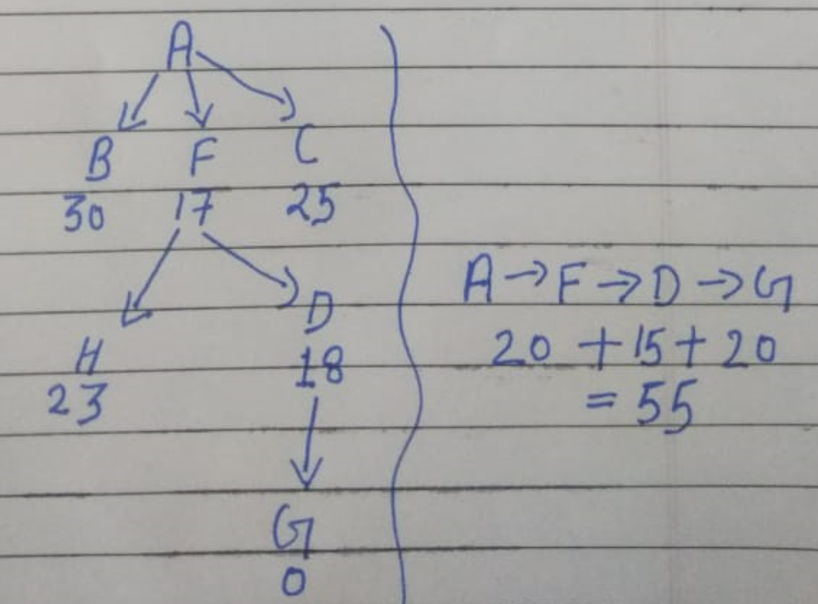
Greedy best-first search

Slide 7
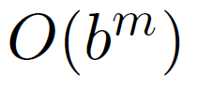
Greedy best-first search
The worst-case time and space complexity is
Where m is the maximum depth of the search space.
With a good heuristic function, however, the complexity can be reduced substantially.
The amount of the reduction depends on the particular problem and on the quality of the heuristic.

Slide 8
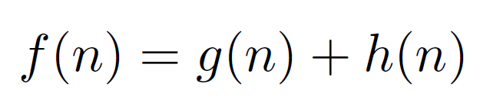
A* search
The most widely known form of best-first search is called A∗ . It evaluates nodes by combining the cost to reach the node, and the cost to get from the node to the goal.
Since g(n) gives the path cost from the start node to node n, and h(n) is the estimated cost of the cheapest path from n to the goal
Then we have f(n) = estimated cost of the cheapest solution through n

Slide 9
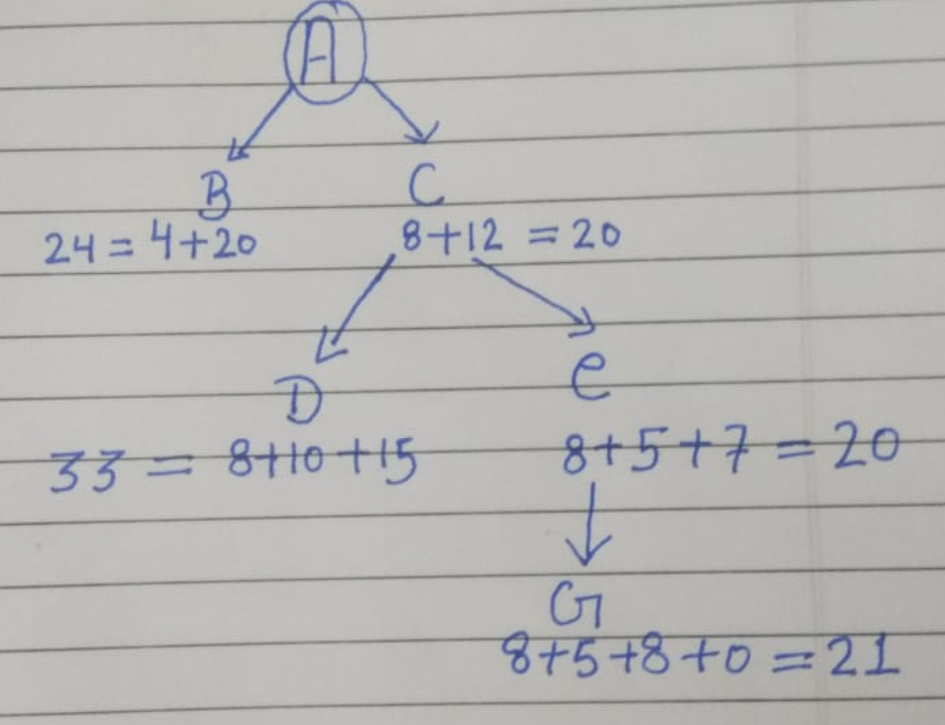
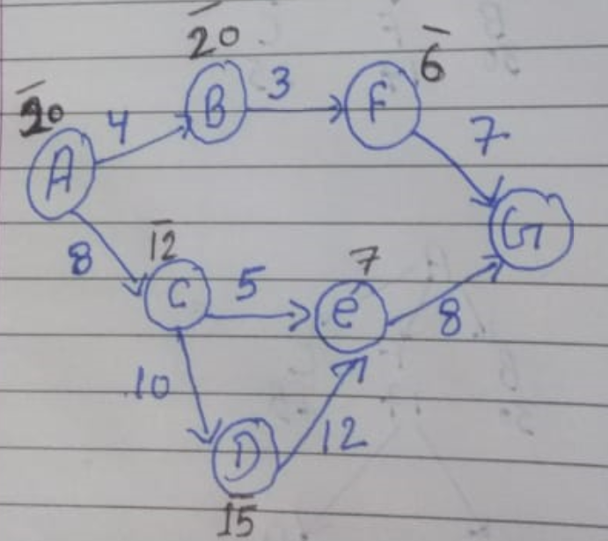
A* search

Slide 10
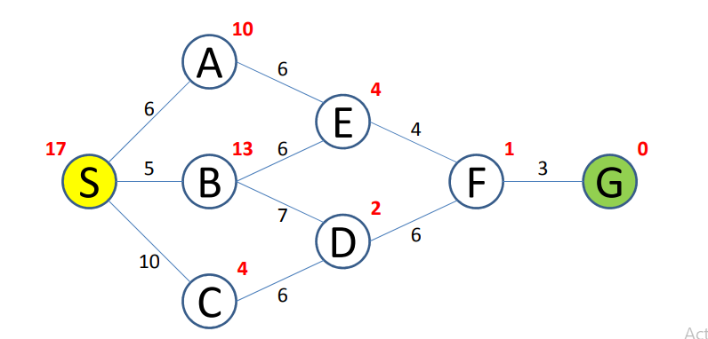

Slide 11
A* search : Admissibility
The condition we require for optimality is that h(n) be an admissible heuristic.
An admissible heuristic is one that never overestimates the cost to reach the goal.
Admissible heuristics are by nature optimistic because they think the cost of solving the problem is less than it actually is.
Straight-line distance is admissible because the shortest path between any two points is a straight line, so the straight line cannot be an overestimate.
h(n) <= h*(n) ------------Underestimation
h(n) > h*(n) ------------Overestimation

Slide 12
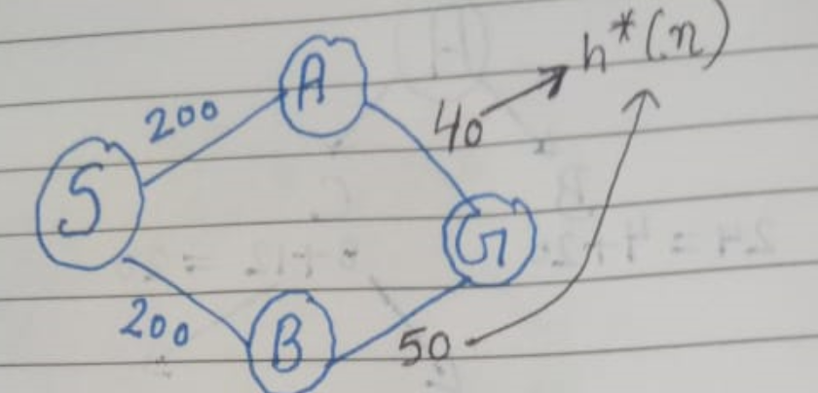
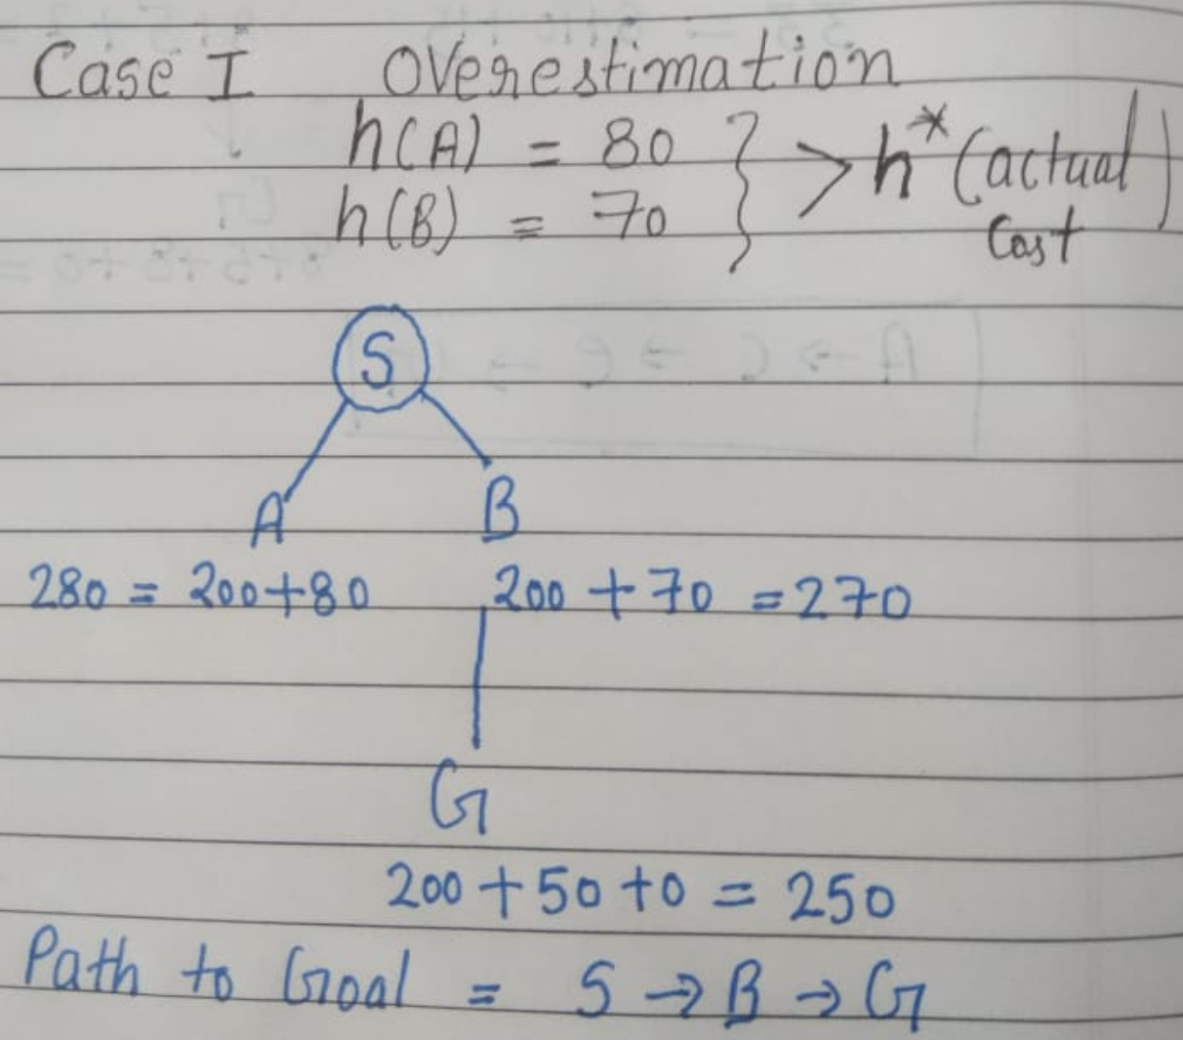
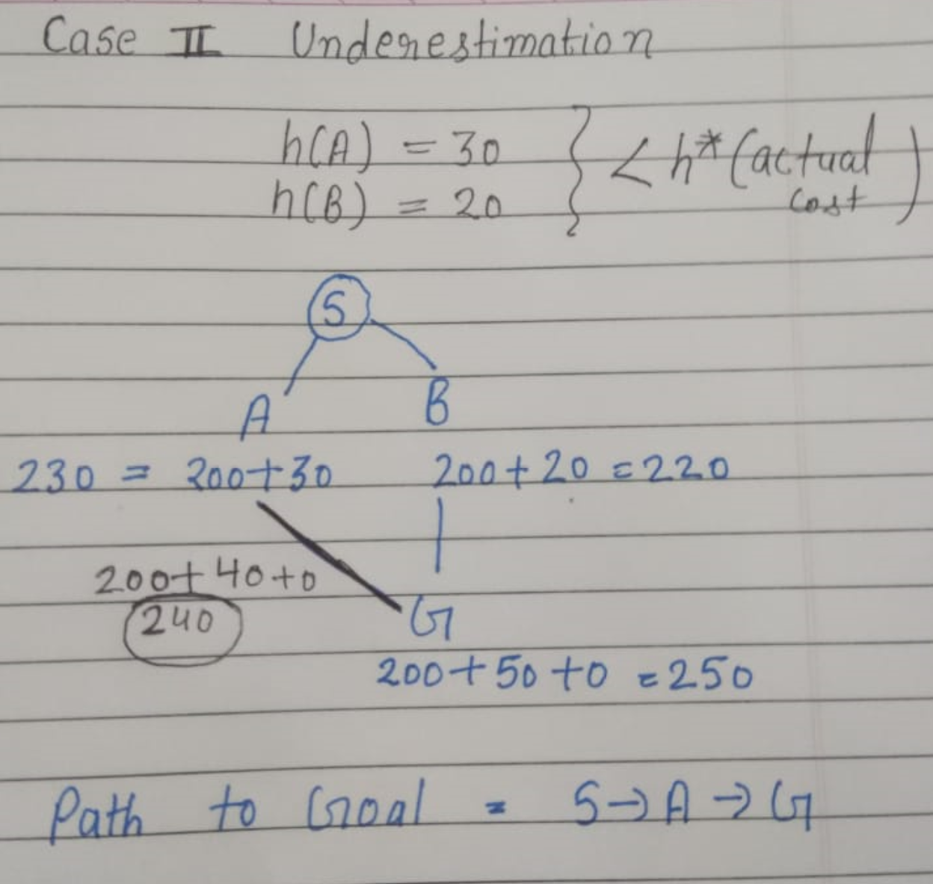
A* search : Admissibility

